Slide 1

VIRTUAL INTELLIGENCE DIRECTORATE
x
OMNIA VINCIT SAPIENTIA
Generic Navy structure
INTREP VID-B-003
NOTE: Virtual Intelligence Directorate (VID) is a fictive intelligence organization created to increase immersion in missions and campaigns hosted and organized by the 132nd Virtual Wing, using DCS (Digital Combat Simulator).
Version: 1.0
Published: 2023-05-18
Notes:
Verson 0.1: Draft 1

Slide 2
Introduction
This report is part of the basic intelligence for 132nd hosted events.
The aim of this report is help pilots understand the role of enemy naval forces.
The structure in this document is generic and the actual structure in a operation is given as intelligence for that operation.

Slide 3
Version control
Version number | Date | Information changed
1.0 | 2023-05-18 | Initial version

Slide 4
Content
Ship roles
Squadron description
Back to content
Back to Air Force
4

Slide 5
Ship roles
Ship | Primary role | Secondary role | Class
Piyotr Vieliky | ASUW/ASW/AAW | C2 | Battlecruiser
Admiral Kutznetzov | Carrier |  | Carrier
Moskva | ASUW/ASW/AAW | C2 | Cruiser
Rezky | ASW | ASUW | Frigate
Neustrashimy | ASW |  | Frigate
Grisha | ASW |  | Corvette
Molnya | ASUW |  | Corvette
SSK 887 Kilo | ASW | ASUW | Submarine
SSK 636 Improved Kilo | ASW | ASUW | Submarine
Ropucha | Amphibious assault |  | Amphibious landing vessel
Type 052B | ASUW | ASW/AAW | Destroyer
Type 052C | AAW | ASW/ASUW | Destroyer
Type 054A | ASW | ASUW/AAW | Frigate
Type 071 | Amphibious assault | C2 | Amphibious landing vessel
Type 093 | ASW | ASUW | Submarine
MV Tilde | Logistical support | Transport | Supply ship
FAC La Combatante | ASUW |  | Fast Patrol Boat
EXPLANATIONS:
ASUW: Anti surface warfare. Combat against other ships on the surface
ASW: Anti submarine warfare. Combat against submarines
AAW: Anti Air Warfare. Air Defense and combat against airborne threats (aircraft and missiles)
C2: Command and control. Flagship role in a SAG
Amphibious assault: Carries amphibious ground forces to a hostile shore
Logistical Support: Supporting either amphibious forces on the ground or ships at sea.
SAG: Surface Action Group. A group of ships operating together. Best utilized with a combined package of ASUW, ASW and AAW supported by a flagship doing command and control

Slide 6
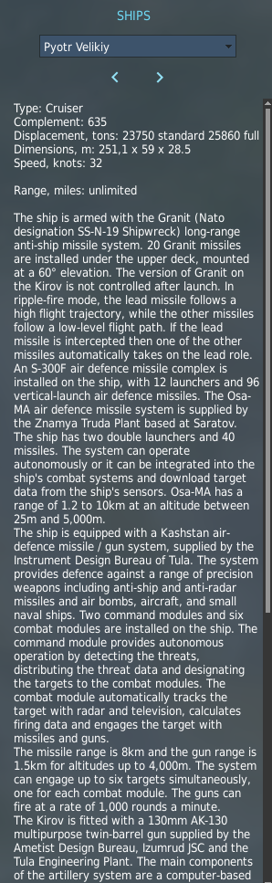
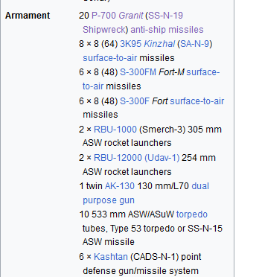
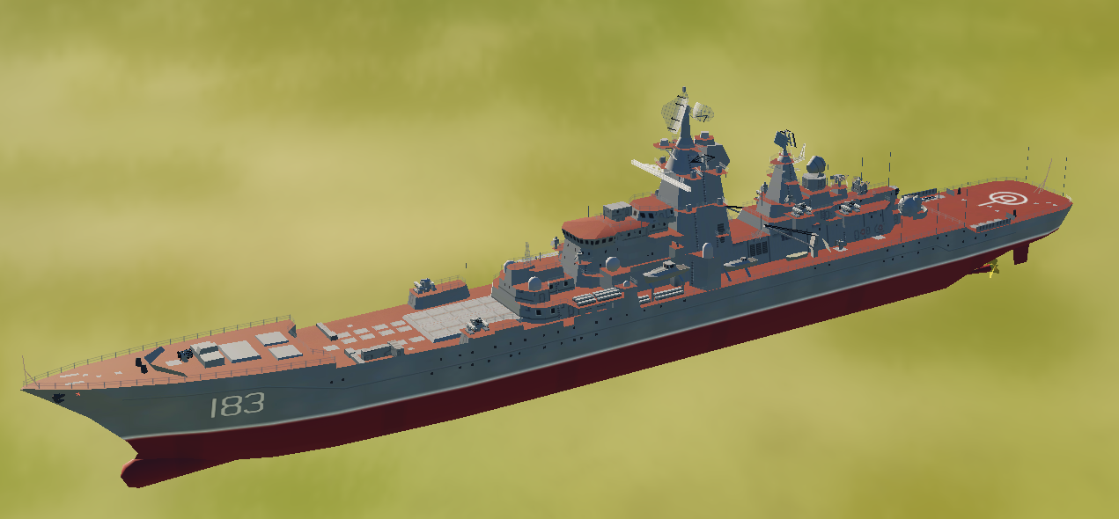
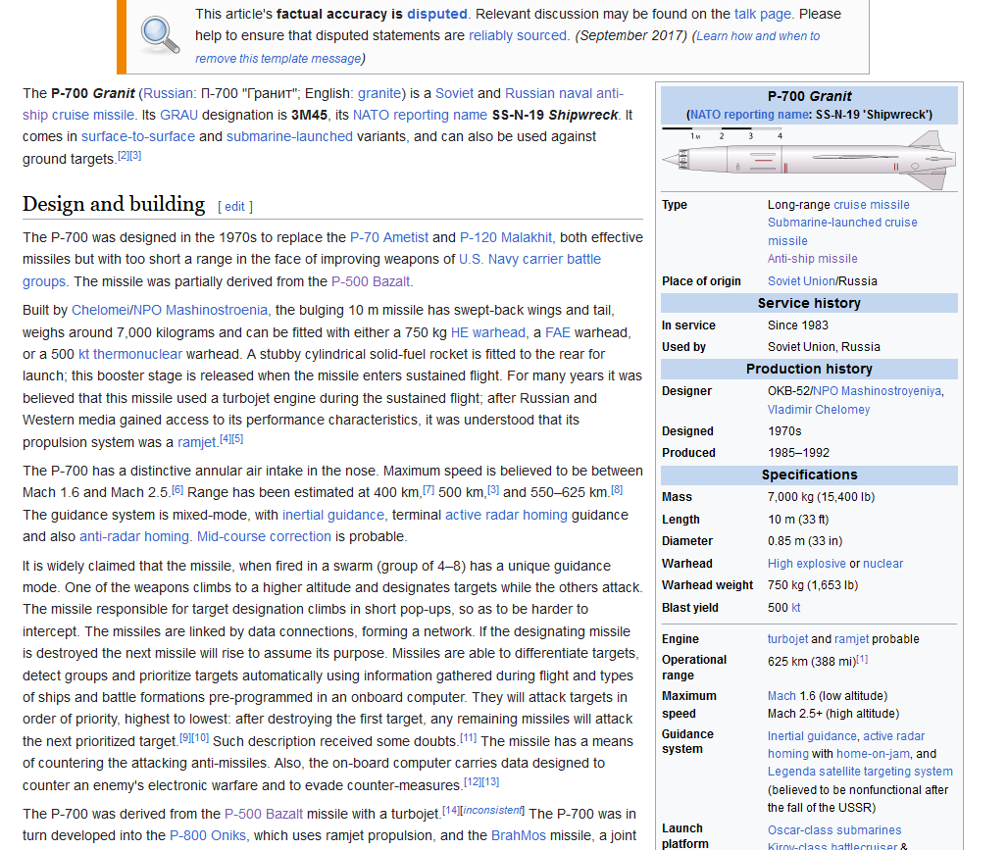
Battlecruiser 1144.2 Pyotr Velikiy
Task: ASUW, ASW, AD
Secondary task: Command and control (Flagship)
Main armament:
20x SS-N-19 Shipwreck antiship missiles (range: 388nm)
96x S300F air defense missiles

Slide 7
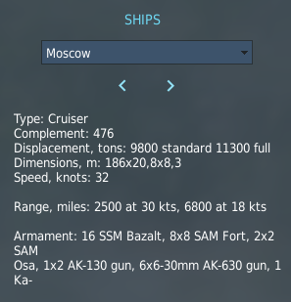
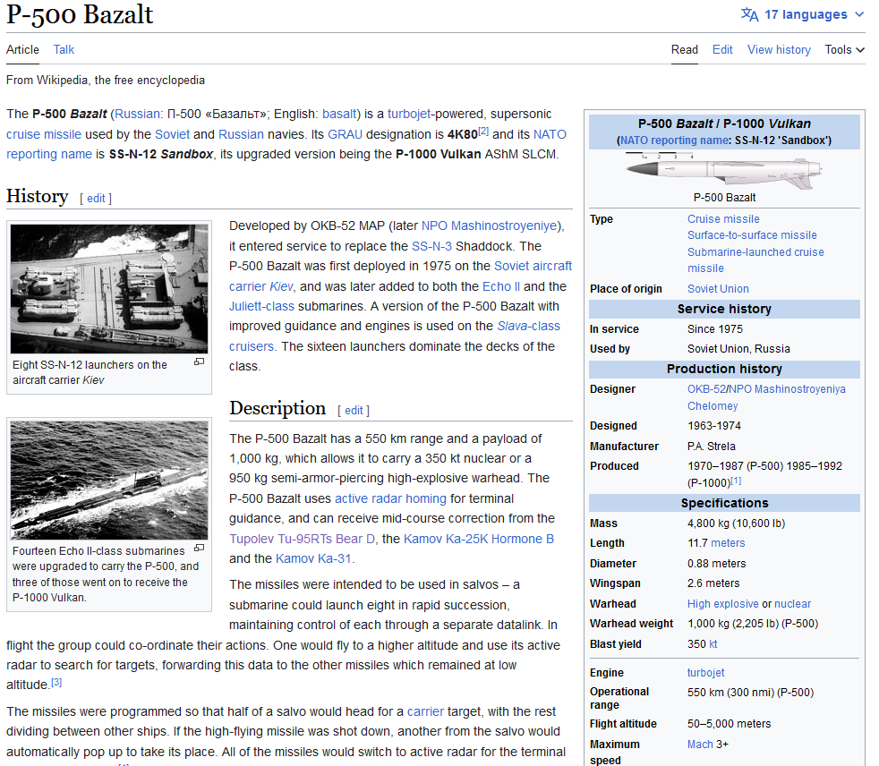
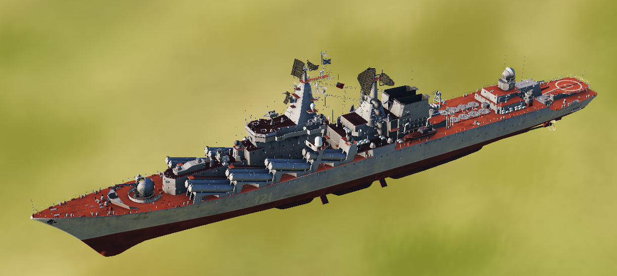
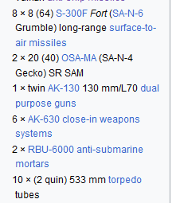
Cruiser 1164 Moskva
Task: ASUW, ASW, AD
Secondary task: Command and control (Flagship)
Main armament:
16x SS-N-12 Sandbox antiship missiles (range: 300nm)
64x S300F air defense missiles

Slide 8
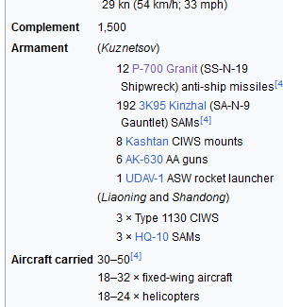
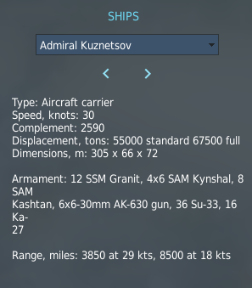
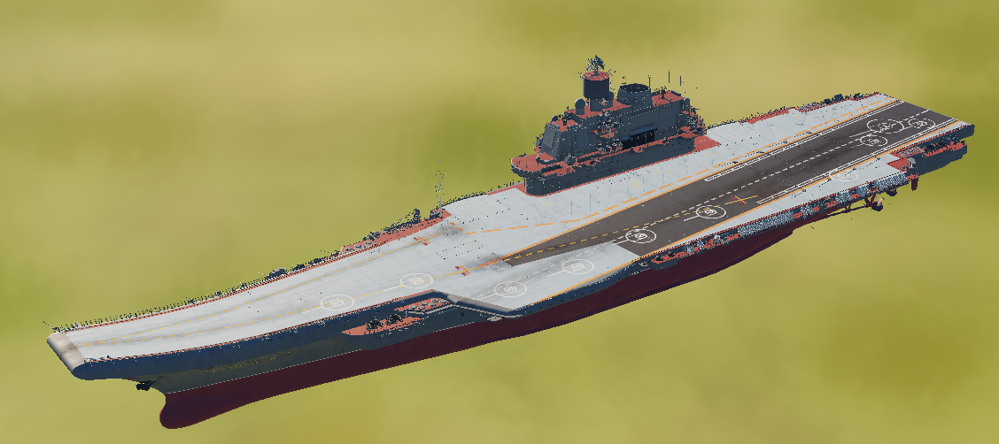
CV 1143.5 Admiral Kutznetzov
Task: Carrier
Secondary task: N/A
Main armament:
32 FW aircraft
24 RW aircraft
12x SS-N-19 Shipwreck antiship missiles (range: 388nm)
192x SA-N-9 Gauntlet air defense missiles

Slide 9
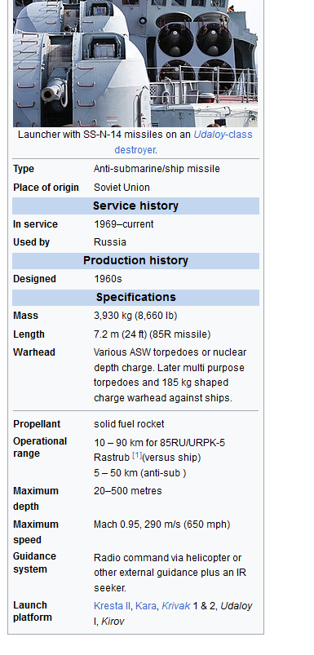
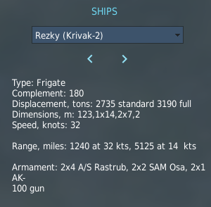
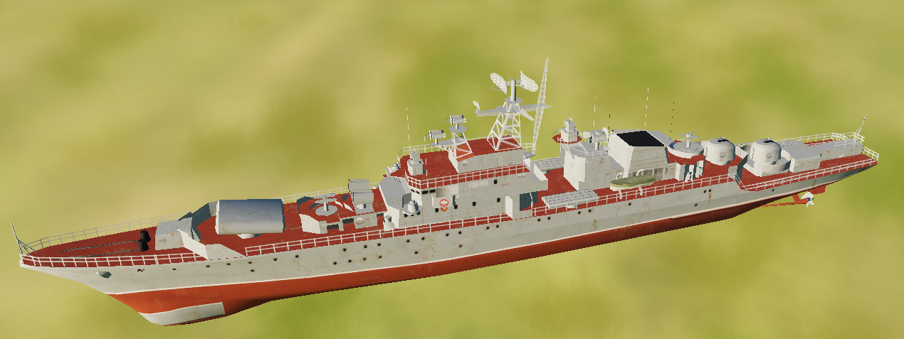
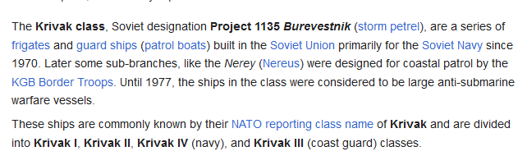
Frigate 1135M Rezky
Task: ASW
Secondary task: ASUW
Main armament:
8x SS-N-14 antiship/antisubmarine missiles (range: 48nm)

Slide 10
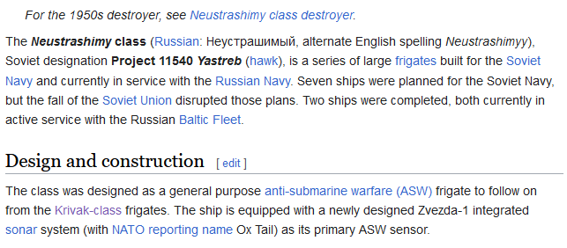
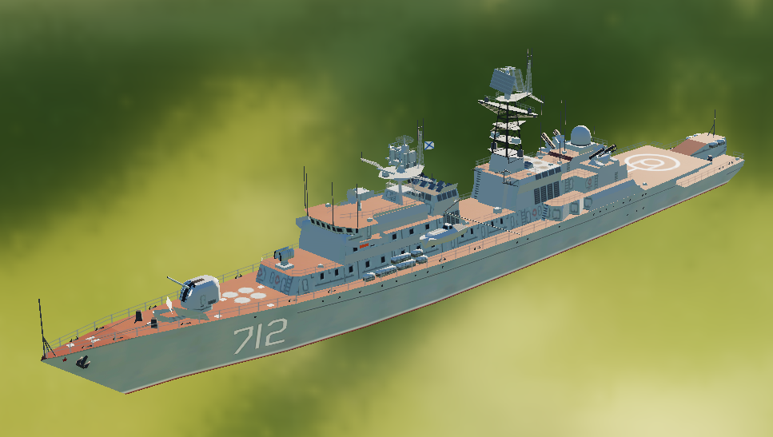
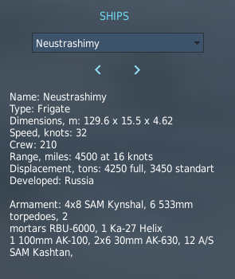
Frigate 11540 Neustrashimy
Task: ASW
Secondary task: N/A
Main armament:
ASW weapons

Slide 11
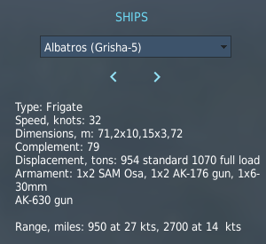
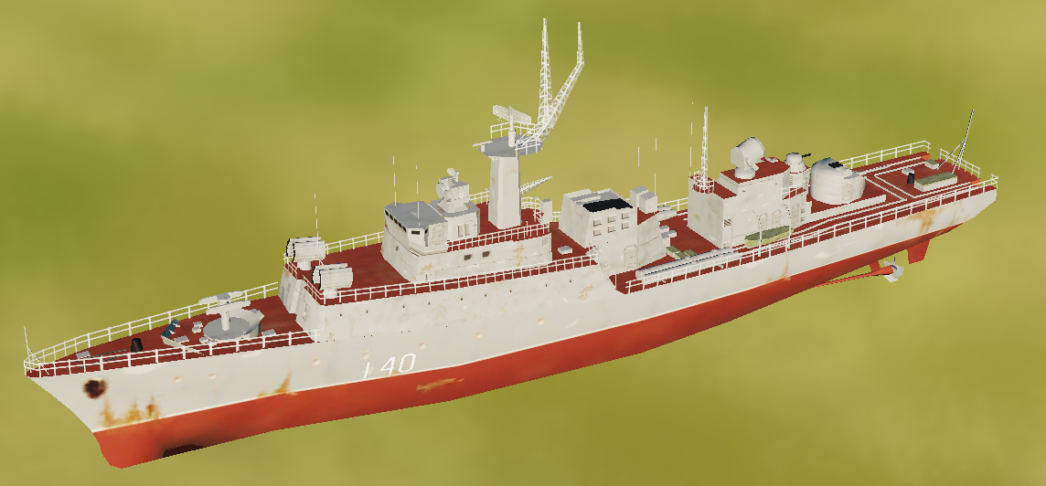
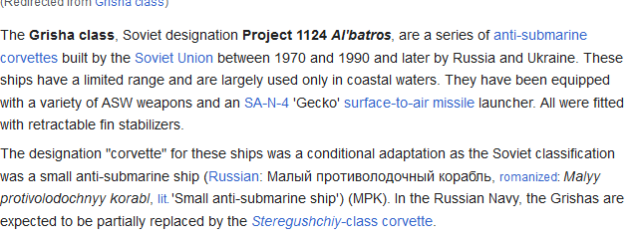
Corvette 1124.4 Grisha
Task: ASW
Secondary task: N/A
Main armament:
ASW weapons

Slide 12
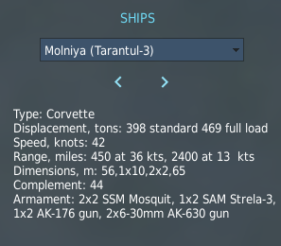
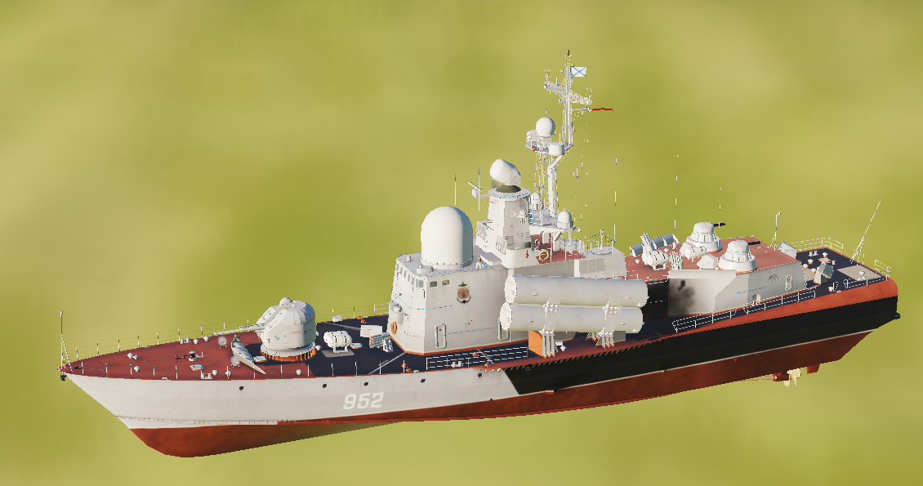
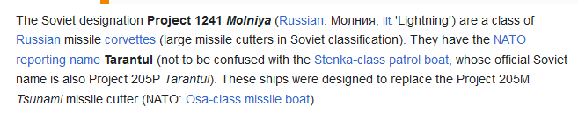
Corvette 1241.1 Molniya
Task: ASUW
Secondary task:
Main armament:
20x SS-N-2 Styx antiship missiles (range: 50nm)

Slide 13
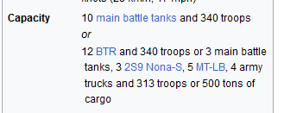
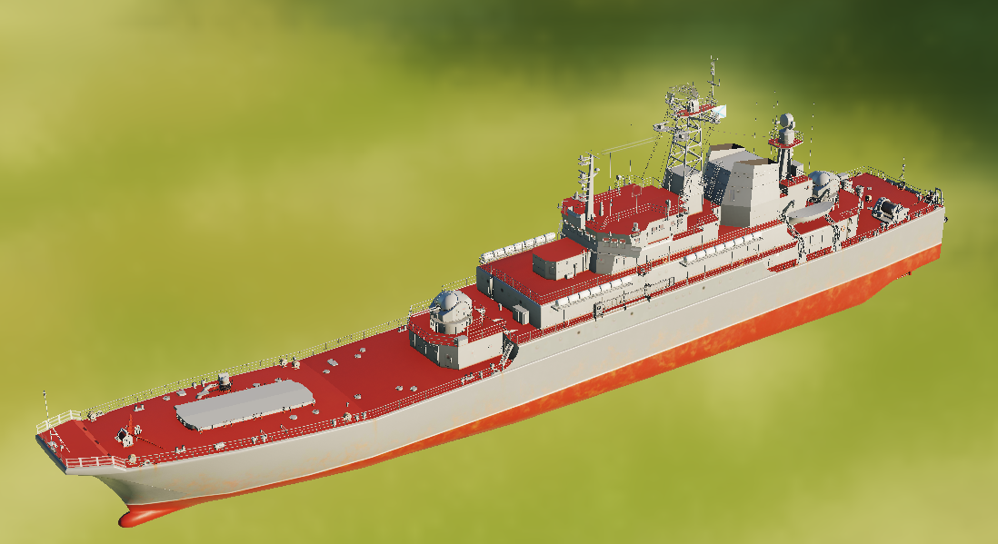
LS Ropucha
Task: Amphibious landing ship
Secondary task:
Main armament:
Self-defense
Capacity:
1 company or battery of ground forces
OR
1 SAM battalion (Limited to: SA-11, SA-6, SA-8, SA-15)
OR
1x Air Defense Battalion

Slide 14
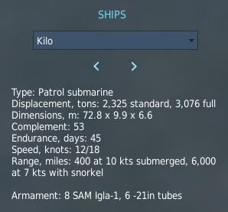
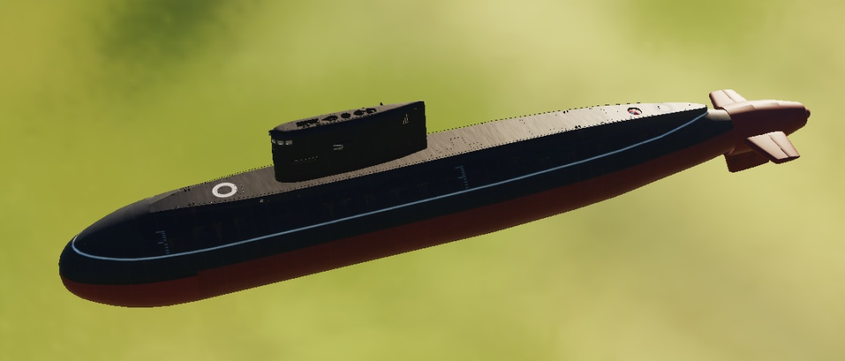
Submarine SSK 887V Kilo
Task: ASW
Secondary task: ASUW
Main armament:
Torpedoes

Slide 15
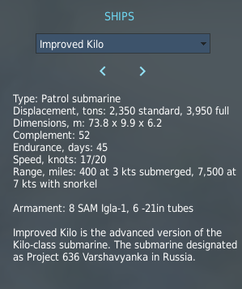
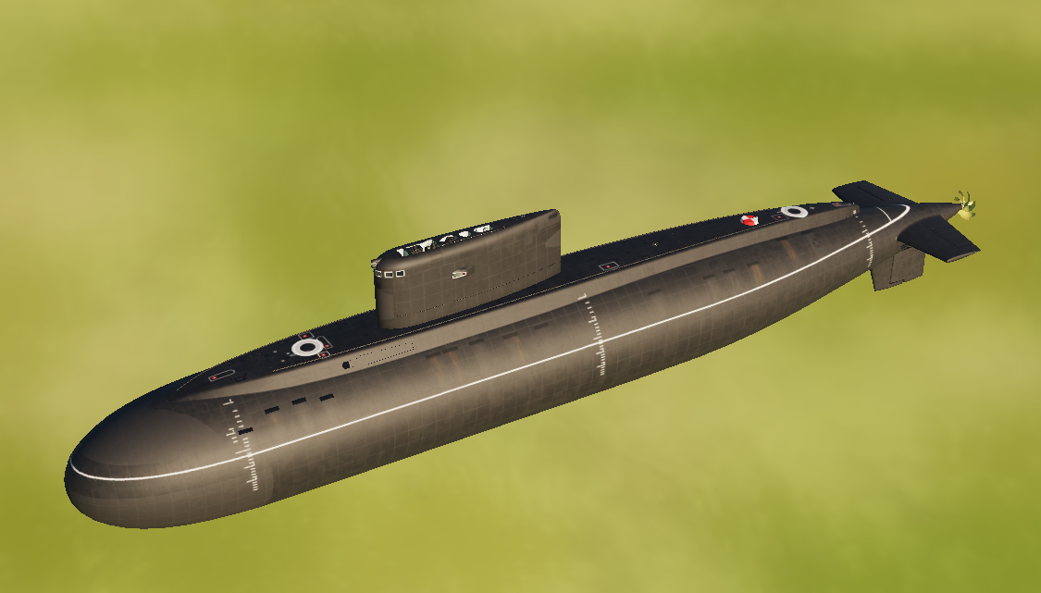
SSK 636 Improved Kilo
Task: ASW
Secondary task: ASUW
Main armament:
Torpedoes

Slide 16
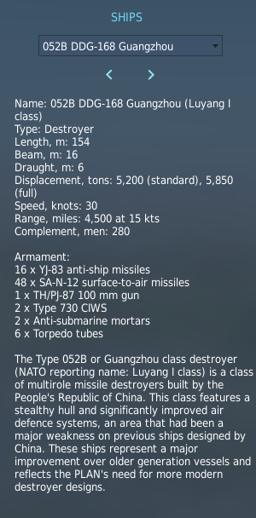
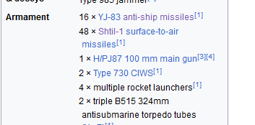
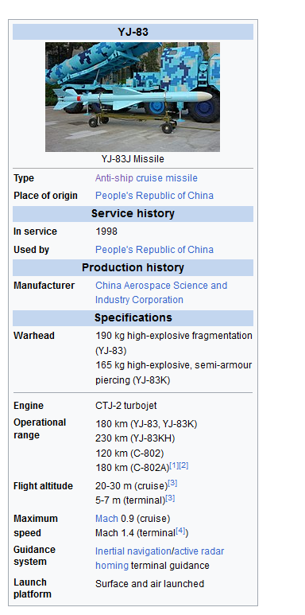
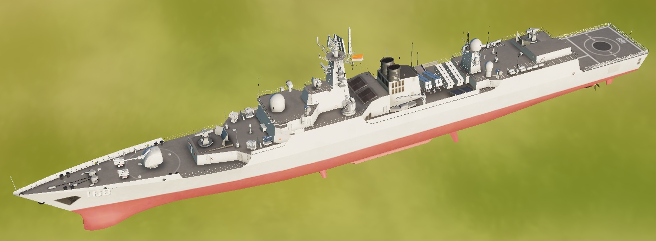
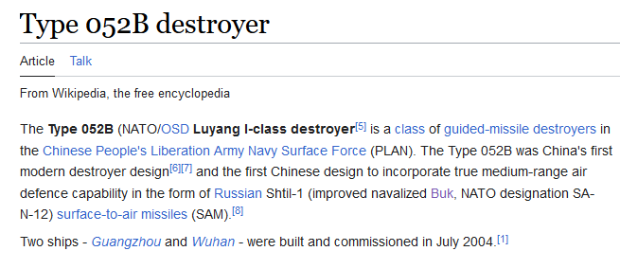
TYPE 052B Destroyer
Task: ASUW
Secondary task: ASW/AD
Main armament:
16x YJ-83 anti-ship missiles (range: 97nm)
48x SA-N-12 air defense missiles

Slide 17
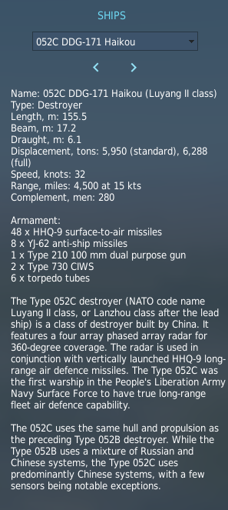
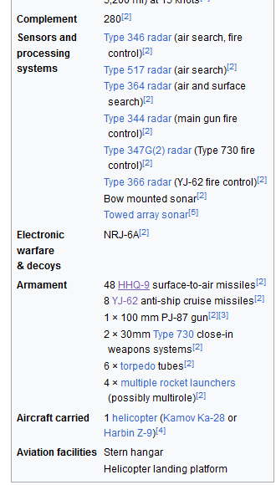
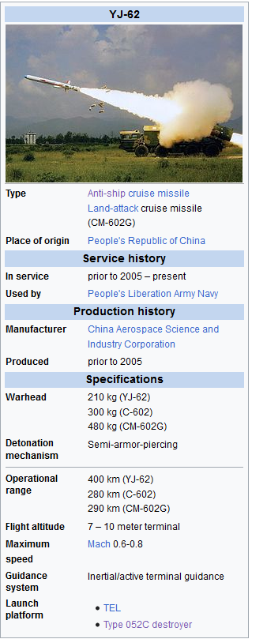
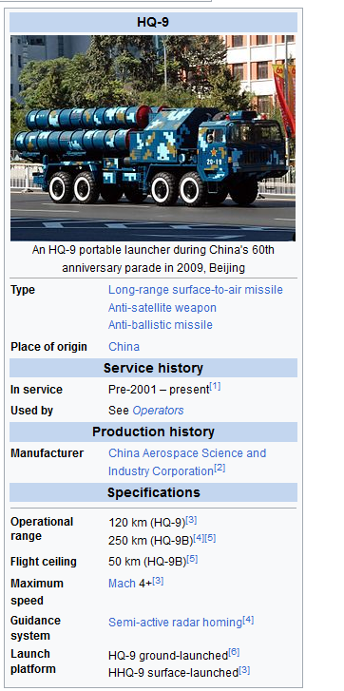
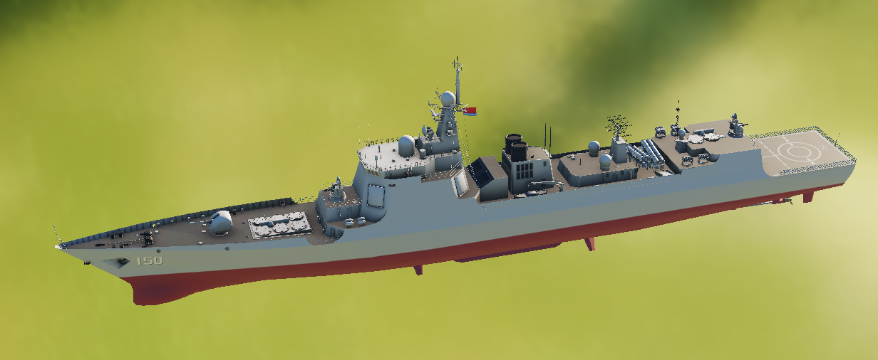
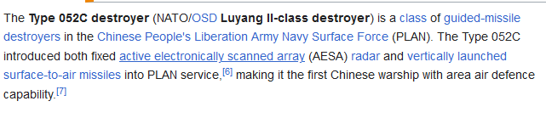
TYPE 052C Destroyer
Task: AD
Secondary task: ASUW/ASW
Main armament:
8x YJ-62 anti-ship missiles (range: 215nm)
48x HHQ-9 air defense missiles

Slide 18
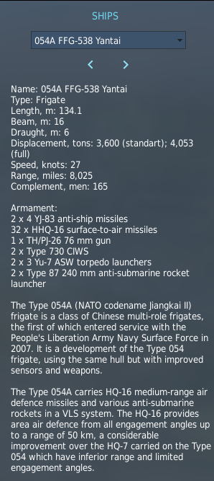
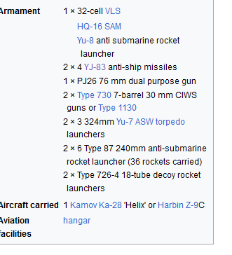
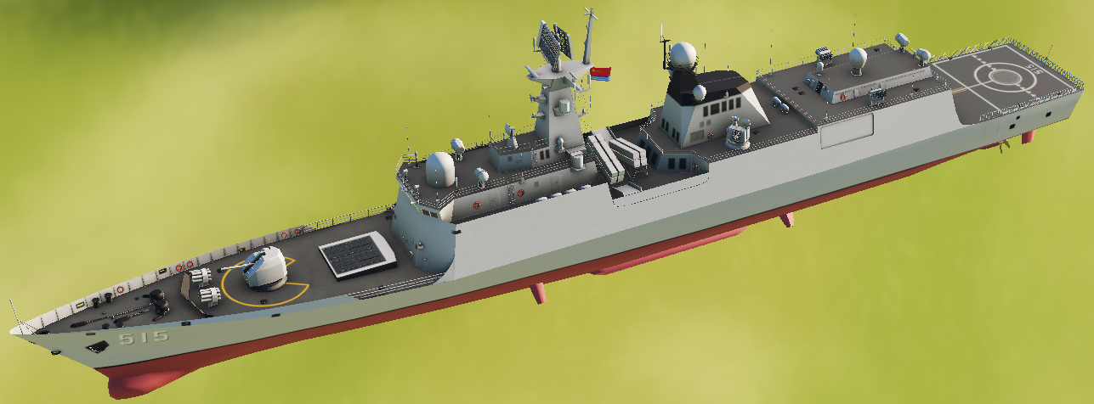
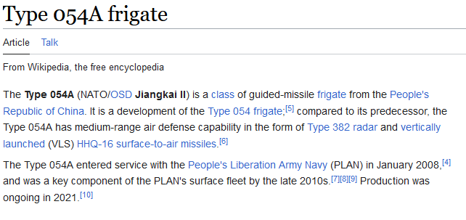
TYPE 054A Frigate
Task: ASW
Secondary task: ASUW/AD
Main armament:
8x YJ-83 anti-ship missiles (range: 97nm)
32x HHQ-16 air defense missiles
ASW weapons

Slide 19
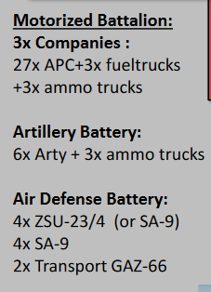
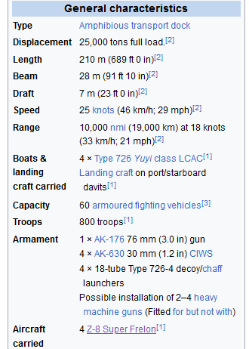
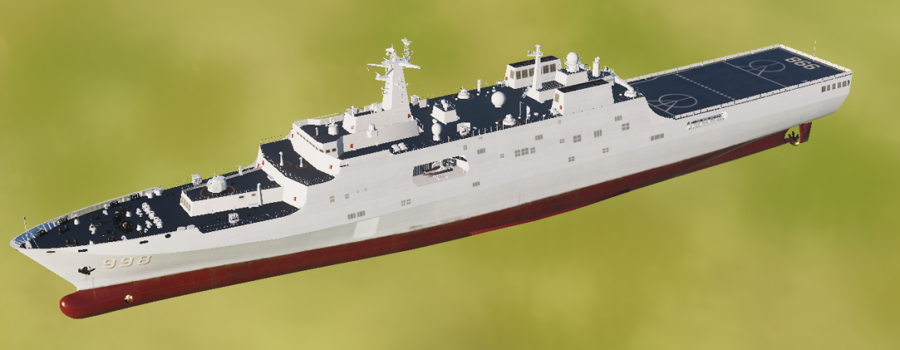
TYPE 071 Amphibious Transport Dock
Task: Amphibious landing ship
Secondary task:
Main armament:
Self-defense
Capacity:
1 Battalion Task Group (Line BN + Air Defense battery+Artillery battery)
33x APC/IFV/MBT + 3 fuel trucks +3 ammo trucks (Line battalion)
6x + 3x ammo trucks Artillery (Artillery battery)
8x SAM/Shilka + 2x Ammo truck (Air Defense Battery)
=52 vehicles
OR
- 60x SAM vehicles or logistical vehicles

Slide 20
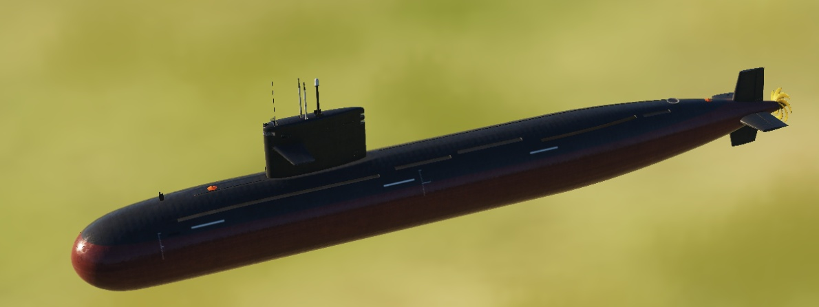
TYPE 093 Attack Submarine
Task: ASW
Secondary task: ASUW
Main armament:
Torpedoes

Slide 21
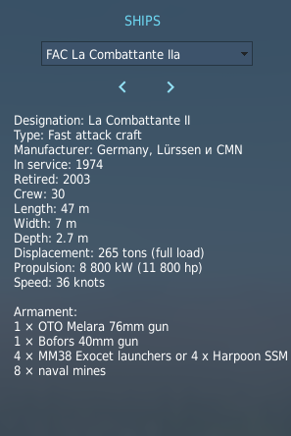


FAC La Combattante IIa
Task: ASUW,
Secondary task: Command and control (Flagship)
Main armament:
4x Exocet anti-ship missiles (Range: 22nm)
OR
- 4x Harpoon anti-ship missiles (Range 75nm)

Slide 22

Supply ship MV Tilde
Task: Logistical support
Secondary task: Transport
Main armament:
N/A
Capacity:
Fuel, food, ammunition for 15 days of operation for ground forces
Fuel, food to resupply ships at sea
Ammunition to reload main armament for ships at sea

